Slide 1

Welcome to EASYMART where convenience meets choice, and shopping becomes an experience

Slide 2

Brief Overview:
This project is an e-commerce website built with HTML, CSS, and JavaScript. Our team has created the core structure using HTML, defining the layout and product information. CSS provides the website's styling and visual design, ensuring a responsive layout across different screens. JavaScript adds interactivity, allowing features like search bars, product selection, and potentially even a shopping cart.

Slide 3
TECH STACKS
HTML: HyperText Markup Language or HTML is the standard markup language for documents designed to be displayed in a web browser. It is often assisted by technologies such as Cascading Style Sheets (CSS) and scripting languages such as JavaScript.
CSS: Cascading Style Sheets (CSS) is a style sheet language used for specifying the presentation and styling of a document written in a markup language such as HTML or XML .
JAVASCRIPT: JavaScript is a scripting or programming language that allows you to implement complex features on web pages — every time a web page does more than just sit there and display static information for you to look at — displaying timely content updates, interactive maps, animated 2D/3D graphics, scrolling video jukeboxes, etc. — you can bet that JavaScript is probably involved.

Slide 4
Bootstrap: Bootstrap (formerly Twitter Bootstrap) is a free and open-source CSS framework directed at responsive, mobile-first front-end web development. It contains HTML, CSS and (optionally) JavaScript-based design templates for typography, forms, buttons, navigation, and other interface components.
API Fetching: The fetch API provides a JavaScript interface for accessing and manipulating parts of the protocol , such as requests and responses. It also provides a global fetch ( ) method that provides an easy , logical way to fetch resources asynchronously across the network.

Slide 5
TEAM MEMBERS:
Name: Roll No: Role:
Gursimran Kaur 2210990350 Fetch API
Kunisha Dhir 2210990528 HTML,CSS
Pinak Dhir 2210990650 CSS,javascript
Pranav Gupta 2210990664 Javascript, Fetch API

Slide 6
OBJECTIVES:
The objective of our e-commerce project is to develop a user-friendly online platform that enables customers to conveniently browse, select, and purchase products or services. that enhances the overall shopping experience for users.
Specifically, our objectives include:
User-Friendly Interface: Designing a responsive and intuitive user interface that ensures easy navigation and seamless interaction for visitors across various devices.
Shopping Cart Functionality: Developing a functional shopping cart system that allows users to add/remove items, view order summaries, and proceed to secure checkout seamlessly.
Secure Payment Processing: Integrating secure payment gateways to facilitate safe and reliable transactions, ensuring customer trust and confidence in the purchasing process.

Slide 7
4.Order Management: Implementing an efficient order management system to track orders, update order statuses, and provide customers with real-time order updates and notifications.
5.Responsive Design: Ensuring that the website is optimized for various screen sizes and devices, providing a consistent and enjoyable user experience regardless of the device being used.
6.Scalability: Building a scalable architecture that can accommodate growth in both product offerings and user traffic, ensuring the website remains robust and reliable as the business expands.

Slide 8
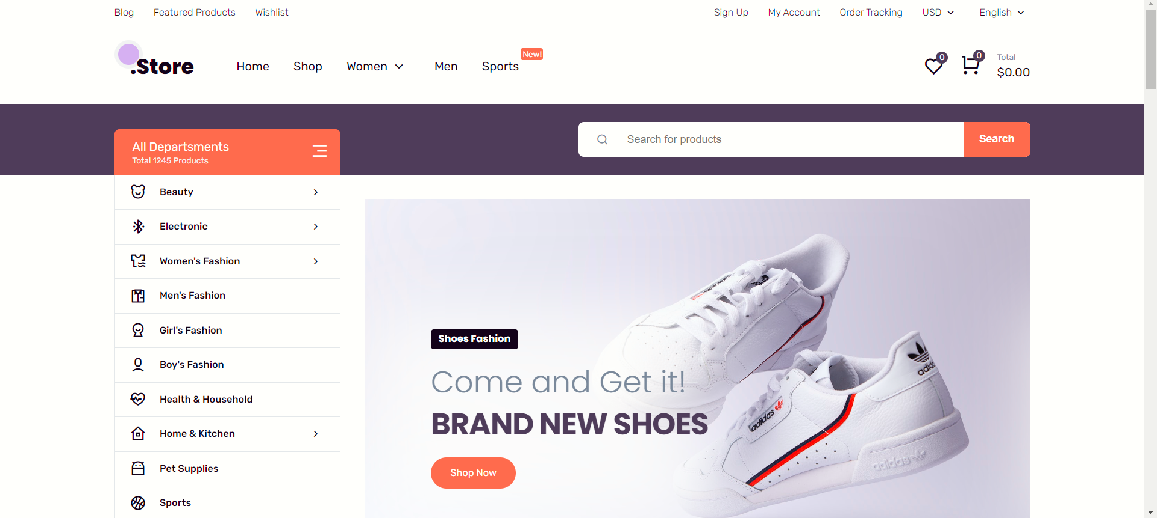
Results:

Slide 9
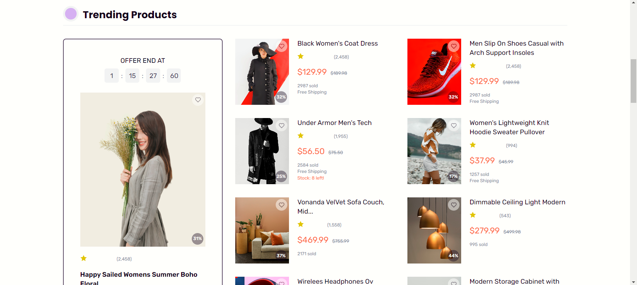

Slide 10
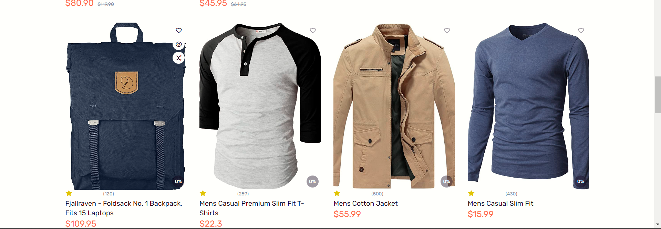

Slide 11
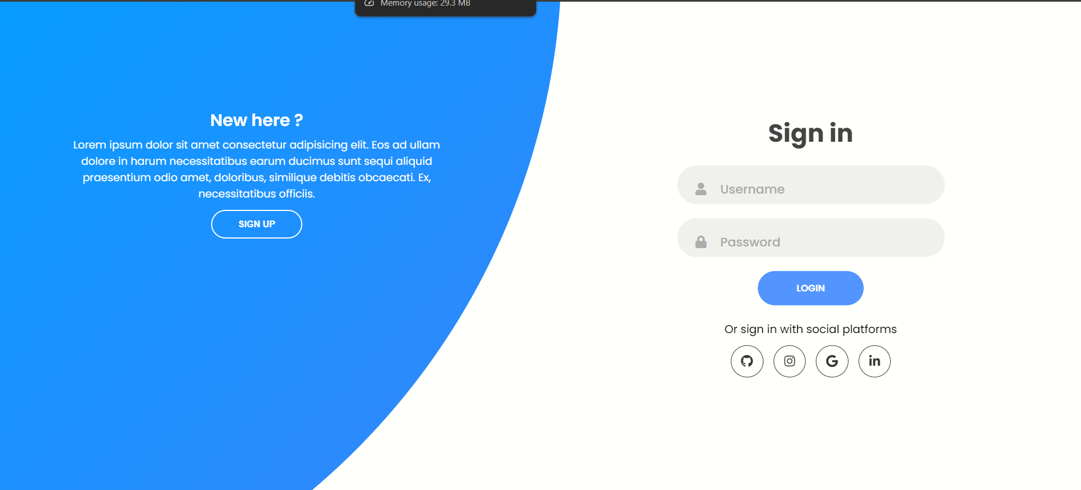

Slide 12


